Slide 1
AI Module - III Heuristic Search

Slide 2
Games
Multiagent environment
Cooperative vs. competitive
Competitive environment is where the agents’ goals are in conflict
Adversarial Search
Game Theory
A branch of economics
Views the impact of agents on others as significant rather than competitive (or cooperative).

Slide 3
Properties of Games
Game Theorists
Deterministic, turn-taking, two-player, zero-sum games of perfect information
AI
Deterministic
Fully-observable
Two agents whose actions must alternate
Utility values at the end of the game are equal and opposite
In chess, one player wins (+1), one player loses (-1)
It is this opposition between the agents’ utility functions that makes the situation adversarial

Slide 4
Why Games?
Small defined set of rules
Well defined knowledge set
Easy to evaluate performance
Large search spaces
Too large for exhaustive search
Fame and Fortune
e.g. Chess and Deep Blue

Slide 5
Games as Search Problems
Games have a state space search
Each potential board or game position is a state
Each possible move is an operation to another state
The state space can be HUGE!!!!!!!
Large branching factor (about 35 for chess)
Terminal state could be deep (about 50 for chess)

Slide 6
Games vs. Search Problems
Unpredictable opponent
Solution is a strategy
Specifying a move for every possible opponent reply
Time limits
Unlikely to find the goal…agent must approximate

Slide 7
Types of Games
 | Deterministic | Chance
Perfect Information | Chess, checkers, go, othello | Backgammon, monopoly
Imperfect Information |  | Bridge, poker, scabble, nuclear war

Slide 8
Example Computer Games
Chess – Deep Blue (World Champion 1997)
Checkers – Chinook (World Champion 1994)
Othello – Logistello
Beginning, middle, and ending strategy
Generally accepted that humans are no match for computers at Othello
Backgammon – TD-Gammon (Top Three)
Go – Goemate and Go4++ (Weak Amateur)
Bridge (Bridge Barron 1997, GIB 2000)
Imperfect information
multiplayer with two teams of two

Slide 9
Optimal Decisions in Games
Consider games with two players (MAX, MIN)
Initial State
Board position and identifies the player to move
Successor Function
Returns a list of (move, state) pairs; each a legal move and resulting state
Terminal Test
Determines if the game is over (at terminal states)
Utility Function
Objective function, payoff function, a numeric value for the terminal states (+1, -1) or (+192, -192)

Slide 10
Game Trees
The root of the tree is the initial state
Next level is all of MAX’s moves
Next level is all of MIN’s moves
…
Example: Tic-Tac-Toe
Root has 9 blank squares (MAX)
Level 1 has 8 blank squares (MIN)
Level 2 has 7 blank squares (MAX)
…
Utility function:
win for X is +1
win for O is -1

Slide 11
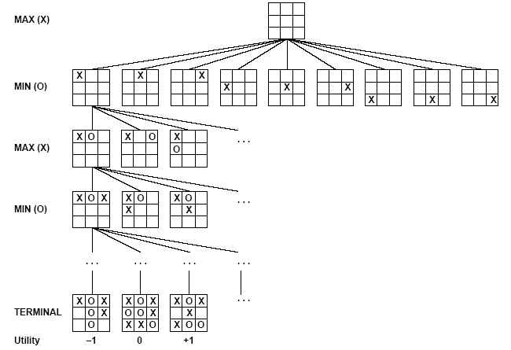
Game Trees

Slide 12
Minimax Strategy
Basic Idea:
Choose the move with the highest minimax value
best achievable payoff against best play
Choose moves that will lead to a win, even though min is trying to block
Max’s goal: get to 1
Min’s goal: get to -1
Minimax value of a node (backed up value):
If N is terminal, use the utility value
If N is a Max move, take max of successors
If N is a Min move, take min of successors

Slide 13
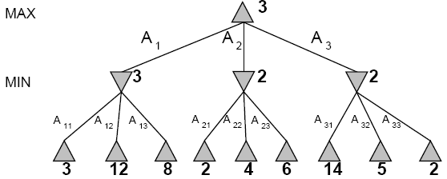
Minimax Strategy

Slide 14
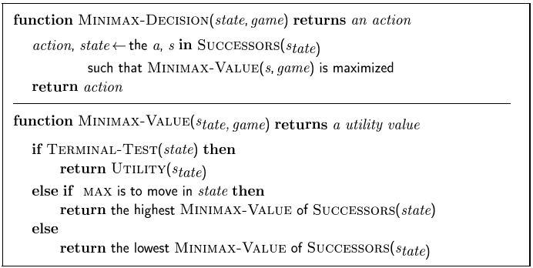
Minimax Algorithm

Slide 15
Properties of Minimax
Complete
Yes if the tree is finite (e.g. chess has specific rules for this)
Optimal
Yes, against an optimal opponent, otherwise???
Time
O(b^{m})
Space
O(bm) depth first exploration of the state space

Slide 16
Resource Limits
Suppose there are 100 seconds, explore 10⁴ nodes / second
10⁶ nodes per move
Standard approach
Cutoff test – depth limit
quiesence search – values that do not seem to change
Change the evaluation function

Slide 17
Evaluation Functions
Example Chess:
Typical evaluation function is a linear sum of features
Eval(s) = w₁f₁(s) + w₂f₂(s) + … + w_{n}f_{n}(s)
w₁ = 9
f₁(s) = number of white queens) – number of black queens
etc.

Slide 18
Alpha-Beta Pruning
The problem with minimax search is that the number of game states it has to examine is exponential in the number of moves
Use pruning to eliminate large parts of the tree from consideration
Alpha-Beta Pruning

Slide 19
Alpha-Beta Pruning
Recognize when a position can never be chosen in minimax no matter what its children are
Max (3, Min(2,x,y) …) is always ≥ 3
Min (2, Max(3,x,y) …) is always ≤ 2
We know this without knowing x and y!

Slide 20
Alpha-Beta Pruning
Alpha = the value of the best choice we’ve found so far for MAX (highest)
Beta = the value of the best choice we’ve found so far for MIN (lowest)
When maximizing, cut off values lower than Alpha
When minimizing, cut off values greater than Beta

Slide 21
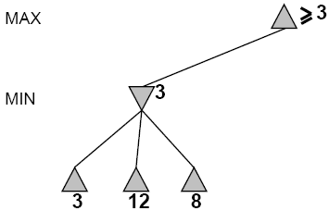
Alpha-Beta Pruning Example

Slide 22
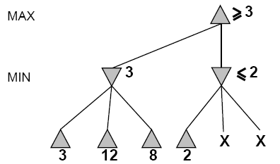
Alpha-Beta Pruning Example

Slide 23
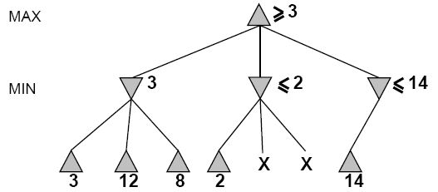
Alpha-Beta Pruning Example

Slide 24
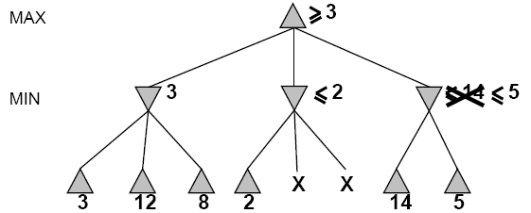
Alpha-Beta Pruning Example

Slide 25
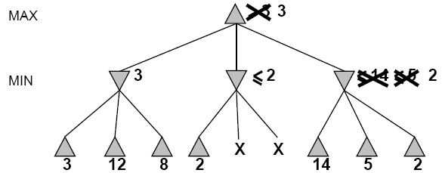
Alpha-Beta Pruning Example

Slide 26
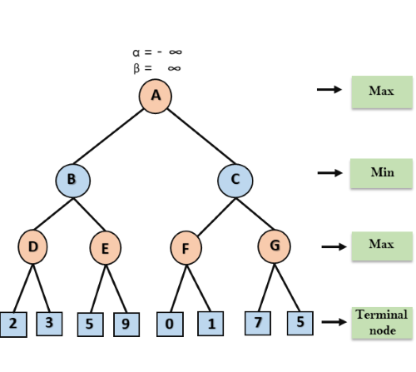
Alpha-Beta Pruning Example-II

Slide 27
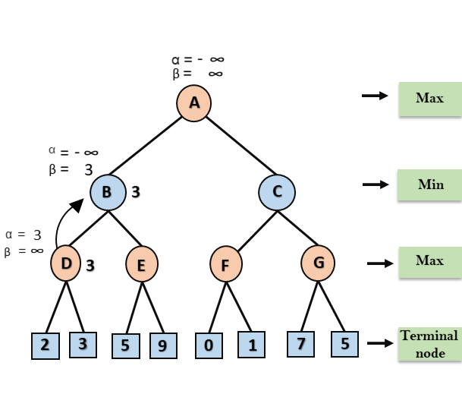

Slide 28
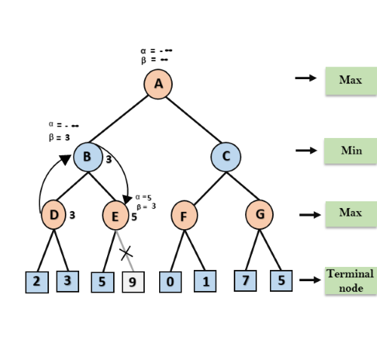

Slide 29
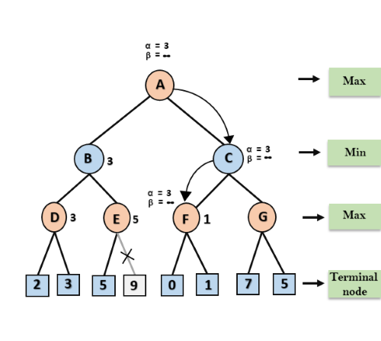

Slide 30
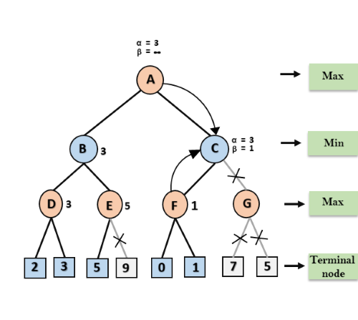

Slide 31
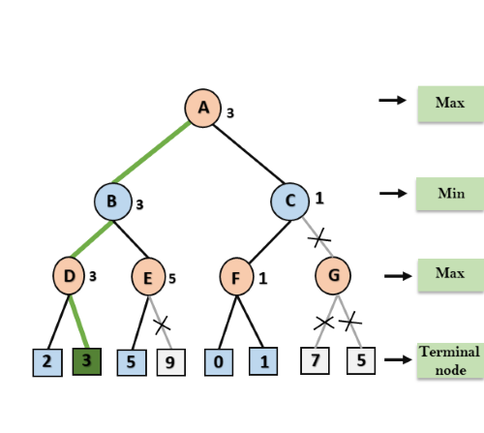

Slide 32
A Few Notes on Alpha-Beta
Effectiveness depends on order of successors (middle vs. last node of 2-ply example)
If we can evaluate best successor first, search is O(b^{d/2}) instead of O(b^{d})
This means that in the same amount of time, alpha-beta search can search twice as deep!

Slide 33
A Few More Notes on Alpha-Beta
Pruning does not affect the final result
Good move ordering improves effectiveness of pruning
With “perfect ordering”, time complexity O(b^{m/2})
doubles the depth of search
can easily reach depth of 8 and play good chess (branching factor of 6 instead of 35)

Slide 34
Optimizing Minimax Search
Use alpha-beta cutoffs
Evaluate most promising moves first
Remember prior positions, reuse their backed-up values
Transposition table (like closed list in A*)
Avoid generating equivalent states (e.g. 4 different first corner moves in tic tac toe)
But, we still can’t search a game like chess to the end!

Slide 35
Cutting Off Search
Replace terminal test (end of game) by cutoff test (don’t search deeper)
Replace utility function (win/lose/draw) by heuristic evaluation function that estimates results on the best path below this board
Like A* search, good evaluation functions mean good results (and vice versa)
Replace move generator by plausible move generator (don’t consider “dumb” moves)

Slide 36
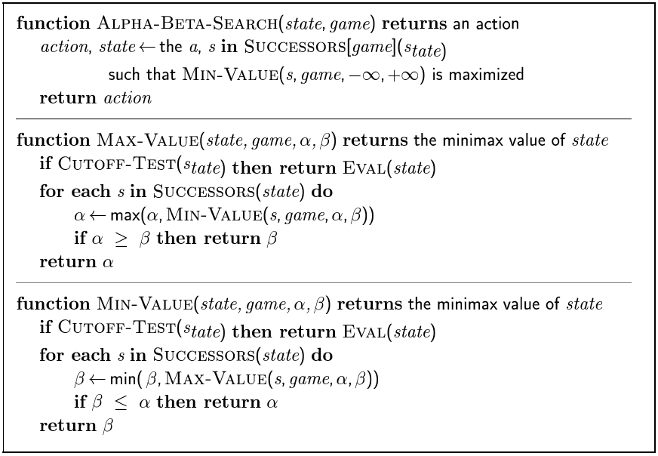
Alpha-Beta Algorithm

Slide 37
Nondeterministic Games
In nondeterministic games, chance is introduced by dice, card shuffling
Simplified example with coin flipping.

Slide 38
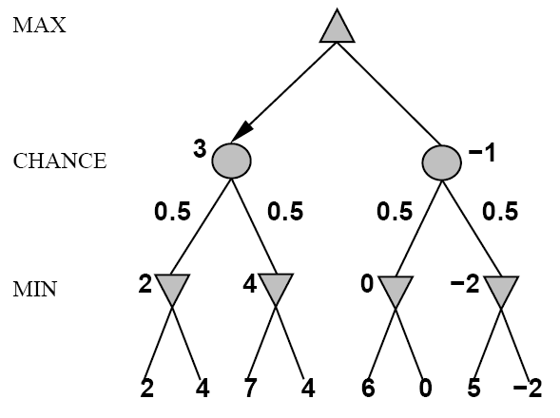
Nondeterministic Games

Slide 39
Algorithm for Nondeterministic Games
Expectiminimax give perfect play
Just like Minimax except it has to handle chance nodes
if state is a MAX node then
return highest Expectiminimax – Value of Successors(state)
if state is a MIN node then
return lowest Expectiminimax – Value of Successors(state)
if state is a CHANCE node then
return average Expectiminimax – Value of Successors(state)

Slide 40
Summary
Games illustrate several important points about AI
Perfection is unattainable -> must approximate
Good idea to “think about what to think about”
Uncertainty constrains the assignment of values to states
Games are to AI as the Grand Prix is to automobile design

